Slide 1
Machine Learning Midterm Project
Kevin Jeswani, Laiba Shah and Junaid Zafar

Slide 2
Agenda
Industry Research/Motivation
Data Problem and Description
Data Understanding
Data Exploration
Data Visualization
Linear Regression
Machine learning model
Approach
Ensemble Methods
Interpreting Results
Business Application

Slide 3
Industry Research - Effects of Indoor Air pollution
Around a third of the global population is affected by harmful household air pollution.
Household air pollution was responsible for an estimated 3.2 million deaths per year in 2020
Household air pollution exposure leads to noncommunicable diseases e.g. stroke, COPD, Lung cancer
Women and children bear the greatest health burden from the indoor pollution
It is essential to identify these household air pollution factors and expand use of clean fuels and technologies[1]
Notes:
Around a third of the global population worldwide cook using open fires or inefficient stoves fuelled by kerosene, biomass and coal, which generates harmful household air pollution.
Household air pollution was responsible for an estimated 3.2 million deaths per year in 2020, including over 237 000 deaths of children under the age of 5.
Household air pollution exposure leads to noncommunicable diseases including stroke, ischaemic heart disease, chronic obstructive pulmonary disease (COPD) and lung cancer.
Women and children bear the greatest health burden from the indoor pollution caused by the use of polluting fuels and technologies in homes
It is essential to expand use of clean fuels and technologies to reduce household air pollution and protect health. These include solar, electricity, biogas, liquefied petroleum gas (LPG), natural gas, alcohol fuels, as well as biomass stoves that meet the emission targets in the WHO Guidelines

Slide 4
Industry Research - Effects of Outdoor Air pollution
The lower the levels of outdoor air pollution affects both long- and short-term.
Air pollution is still significant since recently in 2019, 99% of the world population was living in places where the WHO air quality guidelines levels were not met.
Outdoor air pollution in both cities and rural areas was estimated to cause 4.2 million premature deaths worldwide in 2016.
Some 91% of those premature deaths occurred in low- and middle-income countries, and the greatest number in the WHO South-East Asia and Western Pacific regions.
Policies and investments supporting cleaner and efficient technologies are key to improving air and life quality across the world. [2]
Notes:
By reducing air pollution levels, countries can reduce the burden of deaths from stroke, heart disease, lung cancer, and both chronic and acute respiratory diseases, including asthma.
The lower the levels of air pollution affects both long- and short-term.
The WHO Air Quality Guidelines: Global Update 2021 provide an assessment of health effects of air pollution and thresholds for health–harmful pollution levels.
Air pollution is still significant since recently in 2019, 99% of the world population was living in places where the WHO air quality guidelines levels were not met.
Ambient (outdoor air pollution) in both cities and rural areas was estimated to cause 4.2 million premature deaths worldwide in 2016.
Some 91% of those premature deaths occurred in low- and middle-income countries, and the greatest number in the WHO South-East Asia and Western Pacific regions.
Policies and investments supporting cleaner transport, energy-efficient homes, power generation, industry and better municipal waste management would reduce key sources of outdoor air pollution.[2]

Slide 5
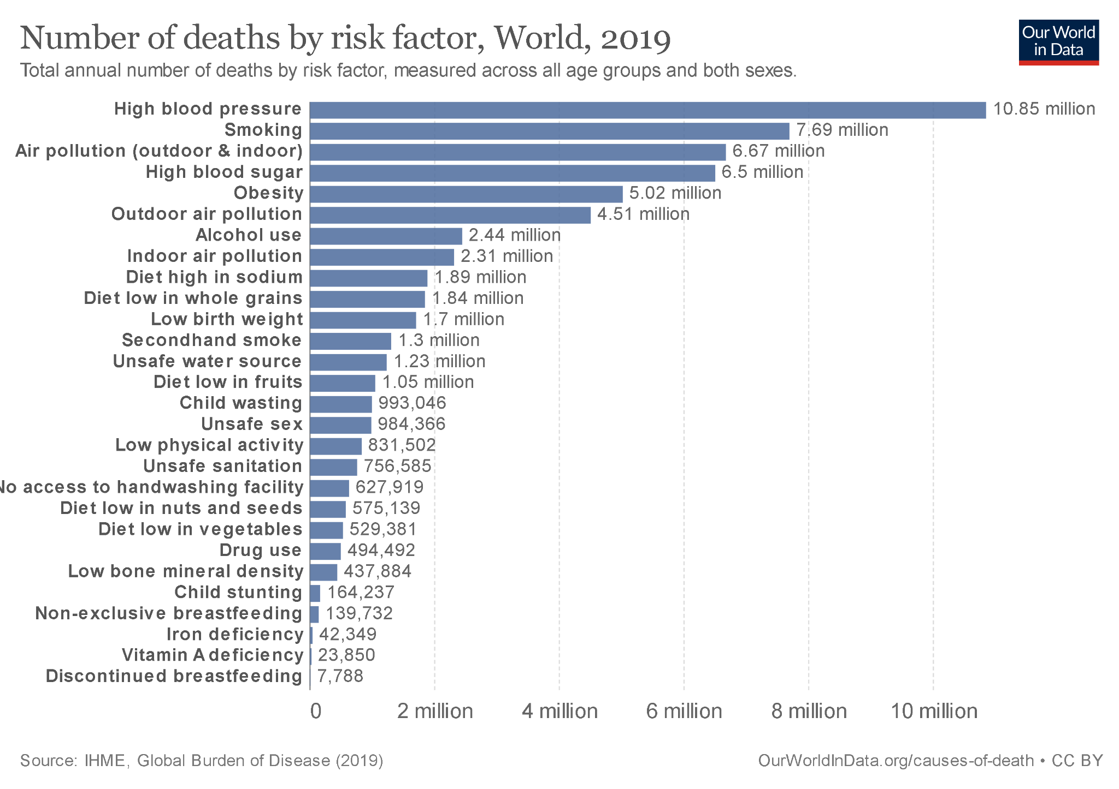
Industry Research
Other prominent factors
Unsafe Water
Unsafe Sanitation
Handwashing[3]

Slide 6
Data Description
Death rate due to indoor air pollution
Death rate due to outdoor particulate matter (PM2.5) air pollution
Death rate due to outdoor ozone air pollution
Social demographic/Internal factors

Slide 7
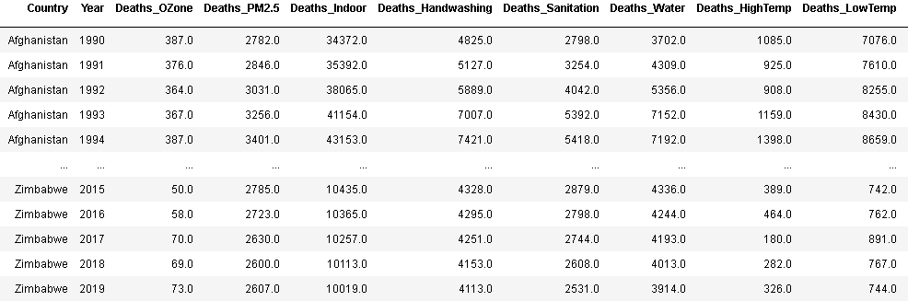
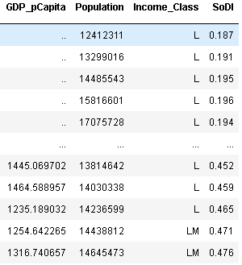
Data Understanding
Data cleaning was performed to remove unnecessary column(s)
Additional data columns were added from OECD and World bank - other env. factors
Socio-Demographic Index, GDP/capita, Population, WB Income Class
A challenge was to merge data sets with the corresponding country and year
Notes:
The base dataset already had deaths normalized per 100,00 people, while the supplemental dataset use raw values that we normalized and combined with GDP/capita, Income Class, and the Socio-demographic Index.

Slide 8
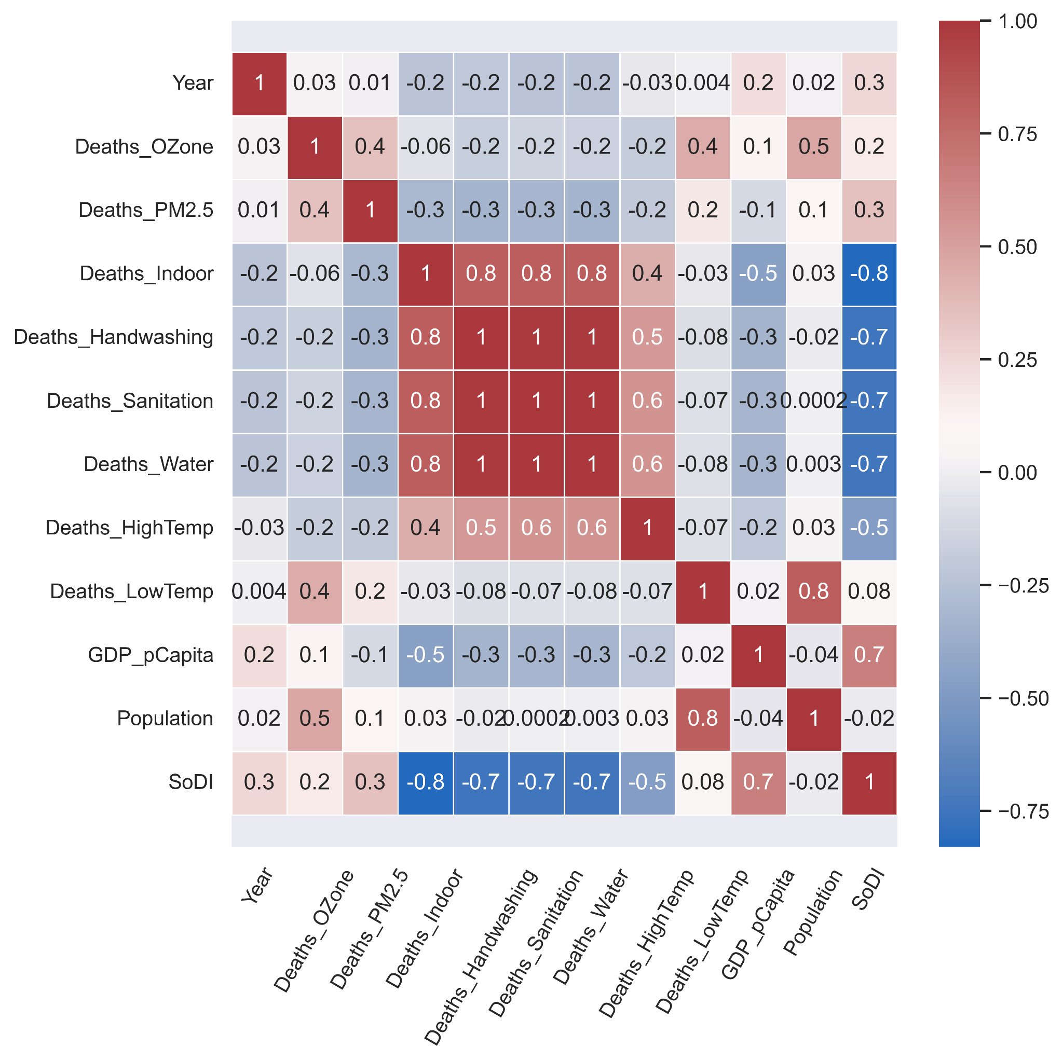
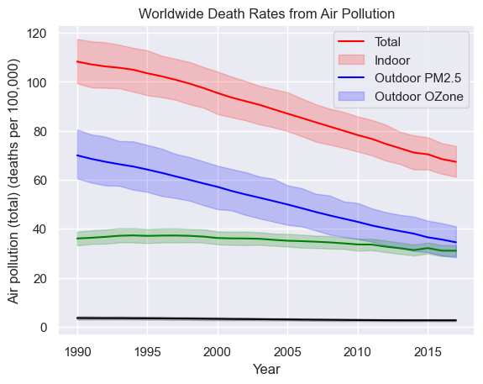
Data Understanding
Visualizations
Most deaths are due to Indoor Air pollution
Overall Death Rates due to Air pollution is going down in the world
Notes:
First focussed on a air pollution death base dataset and found that overall air pollution deaths are decreasing and there is a strong correlation with that total decrease and the decrease in indoor pollution deaths.
When supplemental target indicators and socio/demographic/economic variables were added, It was more difficult to find a pattern with particulate matter and ozone pollution deaths

Slide 9
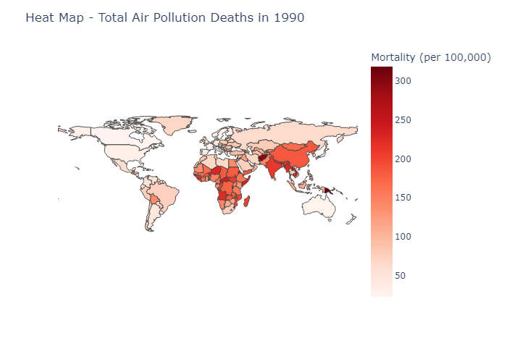
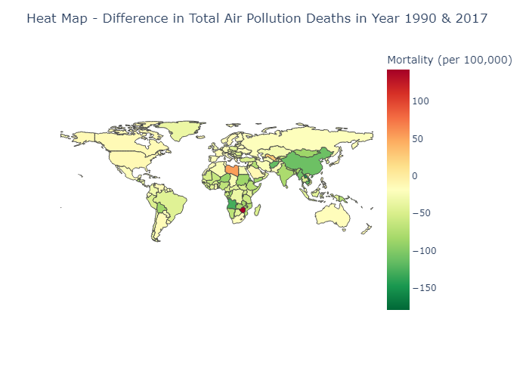
Data Understanding
Heat Maps
Notes:
We conducted a geospatial analysis of countries with varying levels of decrease in total deaths due to air pollution, with Libya, Lesotho, and Uzbekistan having increased level. China, Myanmar, Thailand, Afghanistan, and Angola apear to have made the most progress in decreasing deaths per 100,000

Slide 10
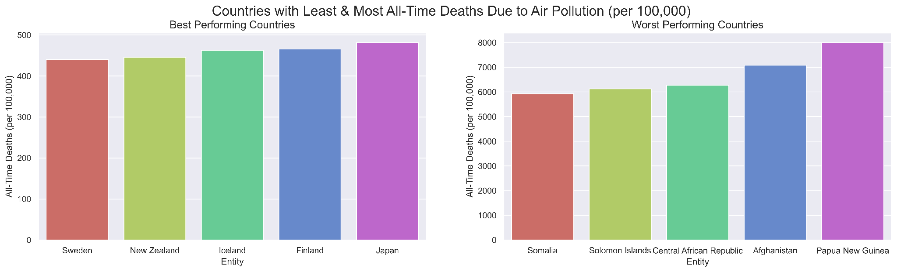
Data Understanding
Barplots
Notes:
We were able to isolate best and worst performing countries in terms of all-time deaths.

Slide 11
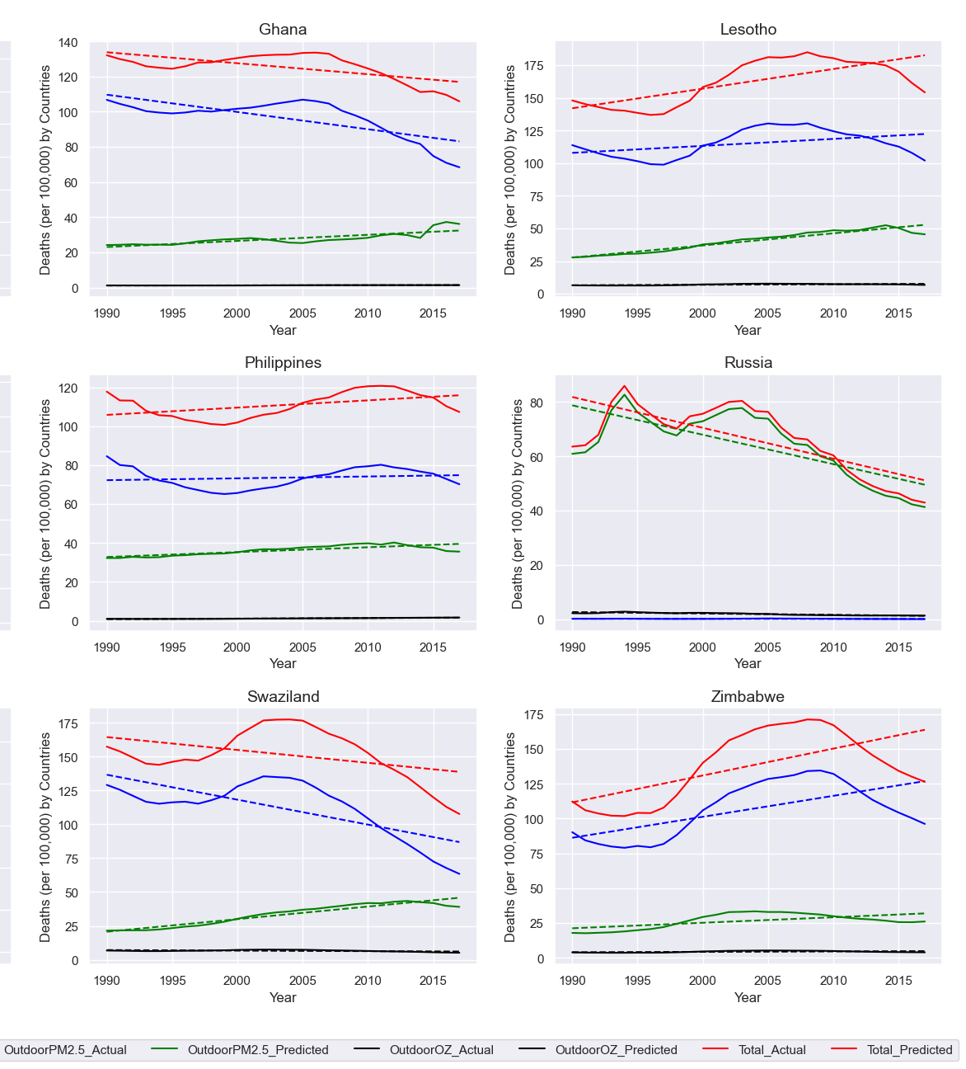
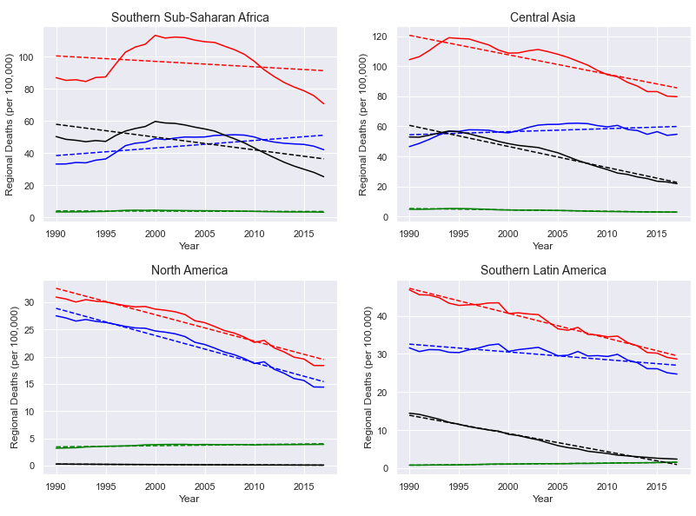
Linear
Regression
R² for All Models | Mean | Std
Indoor . | 0.89 | 0.15
PM2.5 | 0.61 | 0.34
OZone | 0.67 | 0.31
Regional, SoDI &
National-level
Notes:
We were able to isolate best and worst performing regions such as Zimbabwe or Lesotho, but also where linear regression models had a bad fit. Additionally the base data set with just air pollution deaths had summation for different levels of Socio-demographic indices, where we can obviously see the impact of wealth/development on decrease health risks. The model trendlines can then be used to predict the general trend in the death metric into the future to drive policy.

Slide 12
Machine Learning Model
Linear Regression*
Linear Regression*
Linear Regression
Preserve time-series
relationships
*Linear Regression (Regional + Country)
Random Forest
Pycaret
Voting
XGBoost
Ensemble RF, XGB, ET
KNN
Voting
Shuffled time-series, but additional features provide insight
Extra Tree
Voting
Notes:
The modelling process involved some experimentation.
Linear Regression (Regional level + country level) were developed to provide a baseline trend in each of the death metrics at different entity aggregates. Ultimately it proves to be a useful tool in capturing the overall picture that the world is trending in and individual nations.
We lightly tested a KNN model, but to better understand the interaction with added features, we decided to do model selection with PyCaret and also
With Random Forest, XGBoost, and Extra Tree Regressor, where we get more sight from additional features and similar results between all 3 models.
We then used voting in an ensemble model that did not provide much better results than the individual trees but is able to combine the 3 models that could be operationalized
Ultimately linear regression seems to still be the most applicable to the data set given the input features. However, additional features may provide better results.

Slide 13
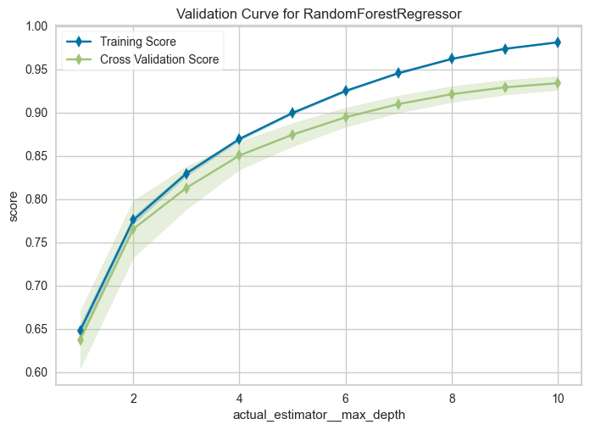
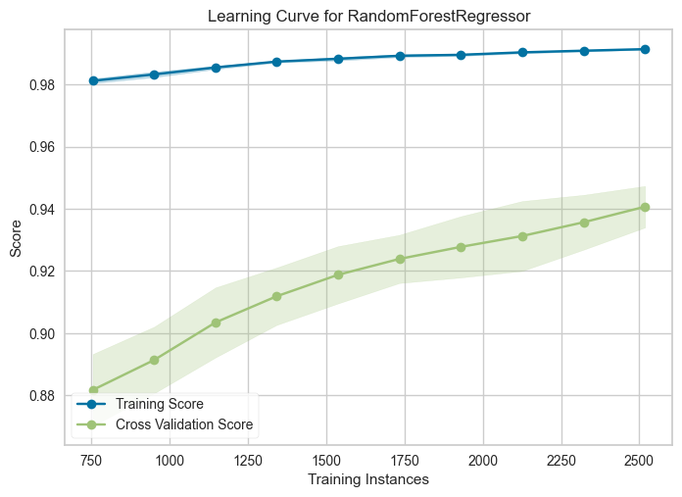
Machine Learning Model
Pre-processing: Ordinal label encoding, removing entries with missing feature values, tested the use of feature and target scaling
Narrowed Target: Air Pollution (Indoor, PM2.5, & OZone) Deaths
Features: Income_Class (encoded), Population, GDP/Capita, SoDI, Year,
PyCaret selection: Indoor & PM2.5 =Random Forest; OZone = Extra Tree, 2nd/3rd option Gradient Boosting
Notes:
PyCaret allowed us to test over 20 models at once and gave some suggested model tuning parameters to start with in building our own trees. It predicted better regression metrics that we were able to achieve with our preliminary models, but we still have room to tune our models. It allowed us to visualize the learning and validation curve so we could gauge what max tree depth to start with when building our own models on the effect on accuracy of training instances

Slide 14
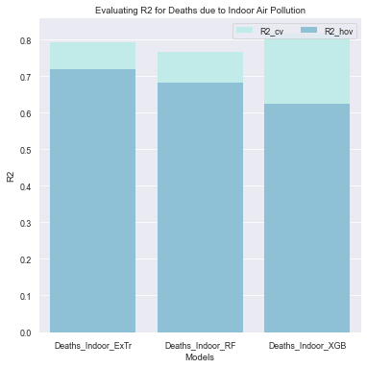
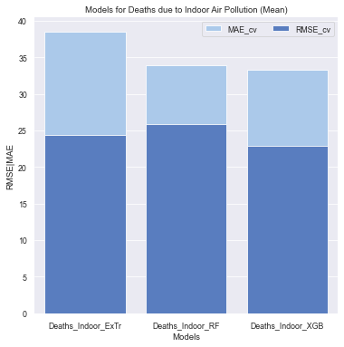
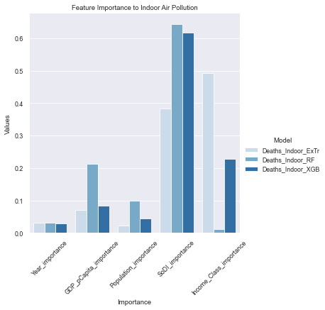
XGB, Random Forest and Extra Trees Models
Max depth = 7
Number of estimators (trees) = 1000 to 2000
65 Train - 20 Test - 15 Hold-Out (attempt to preserve timeseries, but challenging)
Cross-Validation with 10-kfolds
Hold-out Validation
MAE (less bias for outliers)
Created ensemble model with voting of RF, ET, XGB
Notes:
PyCaret gave us insight into how to building our own models. We chose a max depth of about 7 levels in the trees, tested estimators between 1000 to 2000. We used all the features available to us and used default parameters to cap the maximum number of features. We did a 65 train-20 test-15 hold out split, while attempting to preserve entire time series in each set, but ultimately the models shuffle through the elements. We then conducts cross validation with 10 folds and 3 repeats in addition to a hold-out validation which gave us similar scores for the test-train data. WE also use the Mean absolute error as the scoring criterion, but we evaluate models on R2 and RMSE as well.

Slide 15
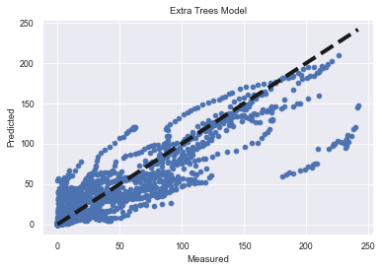
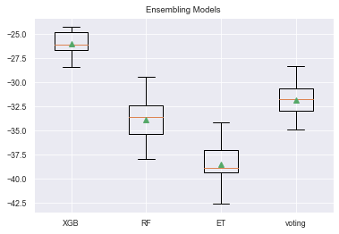
Ensemble Method
Notes:
mean_absolute_error/std
XGB -25.954 (1.175)
RF -33.887 (1.941)
ET -38.489 (1.918)
voting -31.838 (1.594)
Ultimately the tree regressors have similar performance and the voting method doesn't produce a model that is significantly better than any of the 3 individual models

Slide 16
Business Applications
Air pollution can be estimated and concerned organizations can focus on the local political policies to improve life quality in certain countries and regions
This model can be further trained with population and migration data to assess migration patterns across the world
This model can be further trained at city level in a country to focus on the industries that are responsible for the highest pollution rate.
We gathered data on PM2.5 and OZone exposure that could be used to better model those deaths & gain insight.

Slide 17
Conclusions
Predicting indoor pollution deaths (linearity)
PM2.5 and OZone deaths are more challenging (non-linear)
Air pollution deaths are highly dependent on Socio-Demographic Index & moderately dependent on GDP/Capita & Population
LR is useful for predicting general trends per nation (preserved timeseries) vs. Tree-based Regression (predictions on socio-demographic/economic factors).
Future works:
Integrate PM2.5/OZone exposure, and other socio-economic predictors
Explore climate-related risks and historical temperature data
Look at historical spending on environmental protection
Polynomial regressions
Notes:
Socio-demographic index is an accumulation of different health factors and health performance metrics, so it is the best predictor but requires a lot of manual data collection

Slide 18
References
[1] Household air pollution and health, https://www.who.int/news-room/fact-sheets/detail/household-air-pollution-and-health, Data accessed: October 18, 2022
[2] Ambient (outdoor) air pollution, https://www.who.int/news-room/fact-sheets/detail/ambient-(outdoor)-air-quality-and-health, Data accessed: October 18, 2022
[3] Hygiene, https://ourworldindata.org/hygiene, Data accessed: October 18, 2022

